Slide 1
Anatomy of Chicken

Slide 2
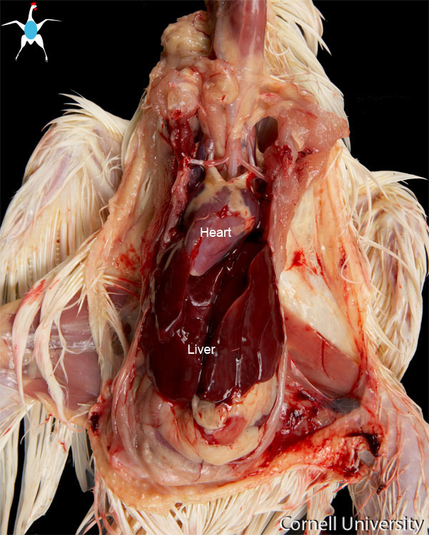

Slide 3
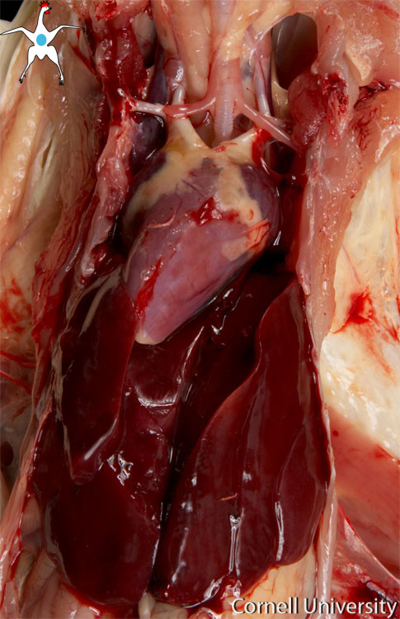

Slide 4
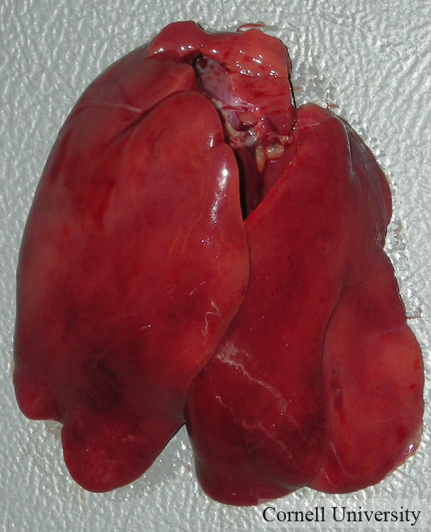

Slide 5
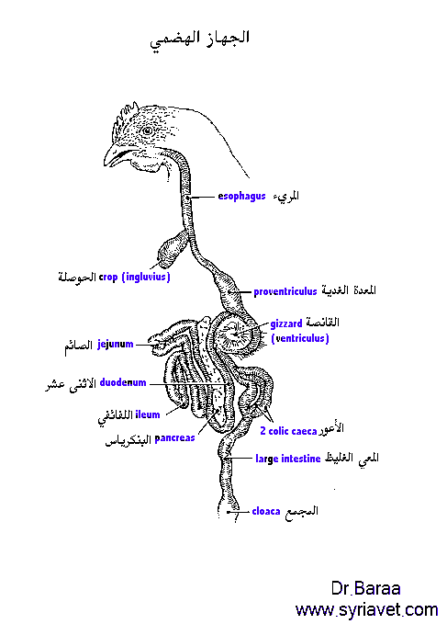

Slide 6
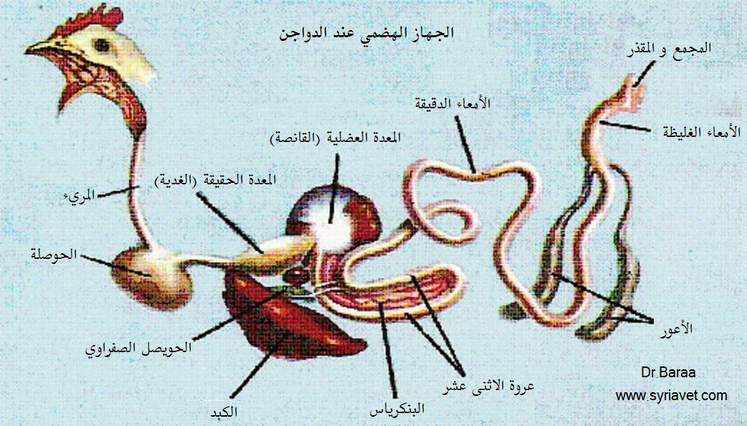

Slide 7
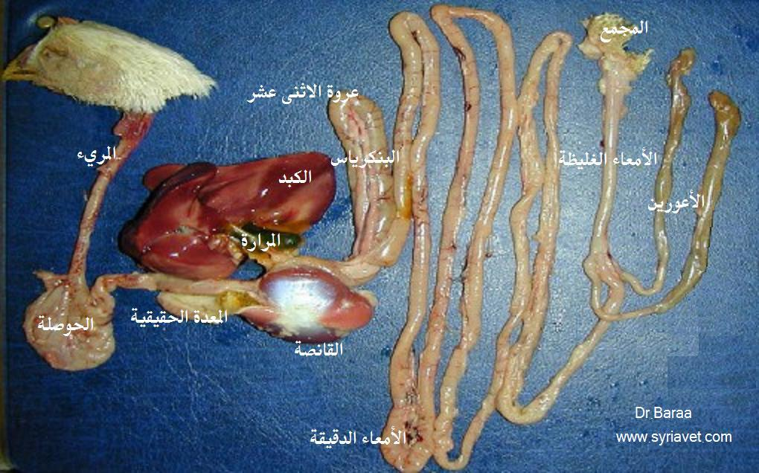

Slide 9
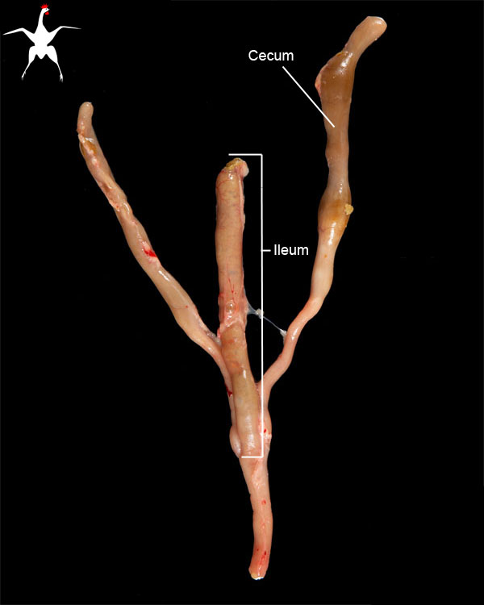

Slide 10
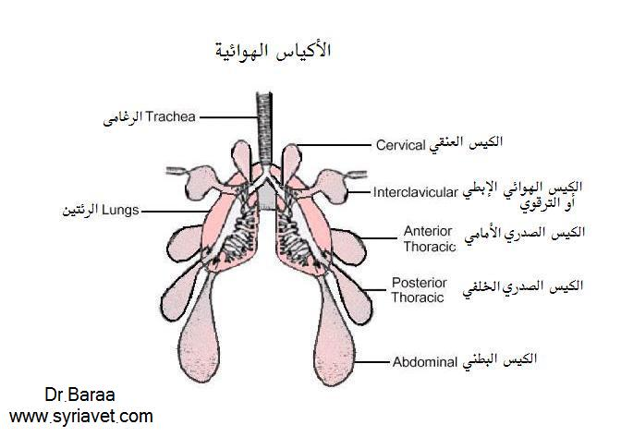

Slide 11
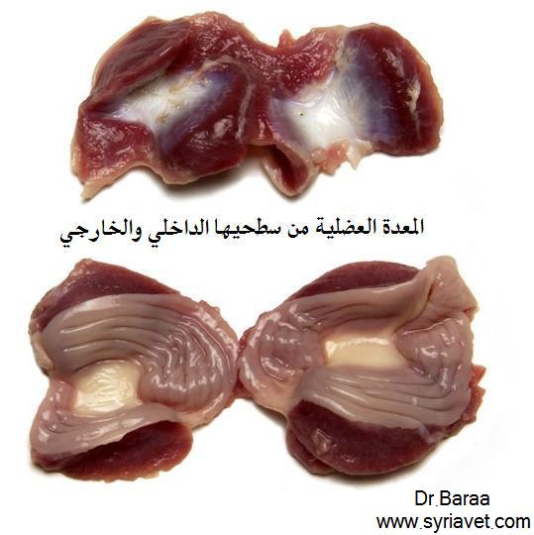

Slide 12
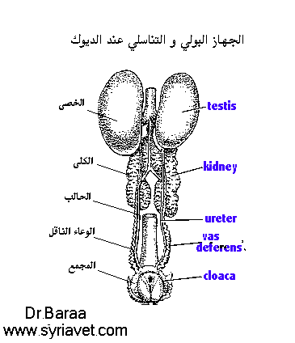

Slide 13
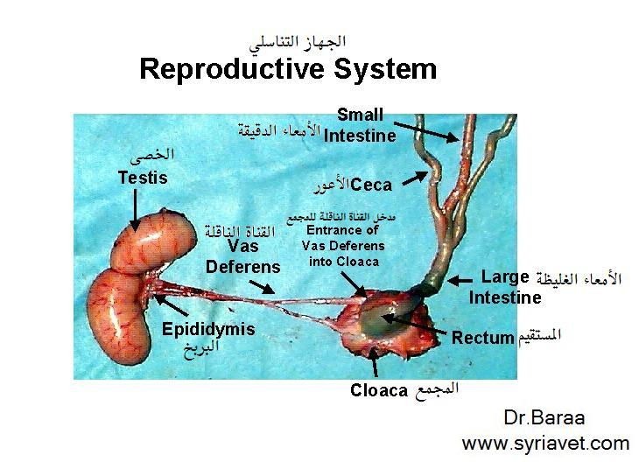

Slide 17
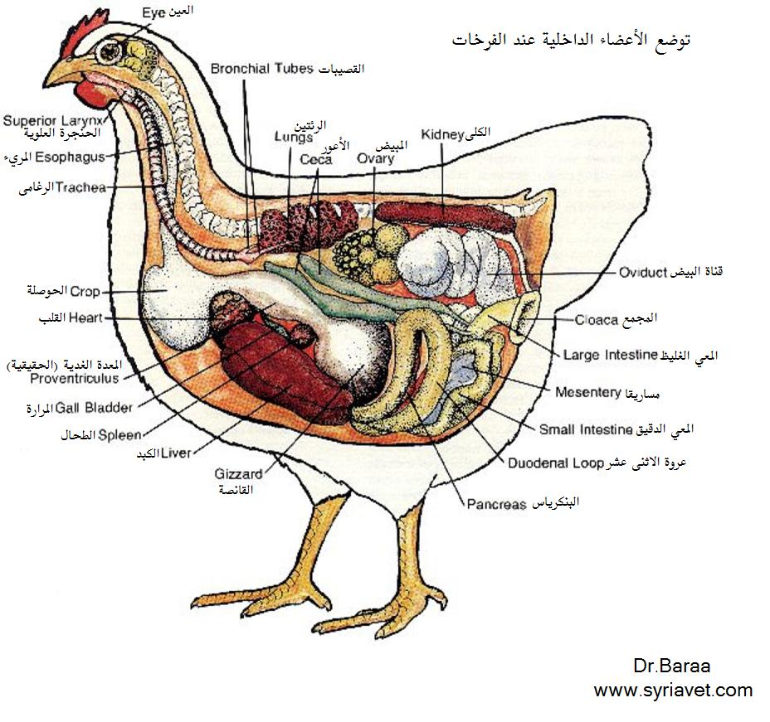

Slide 18
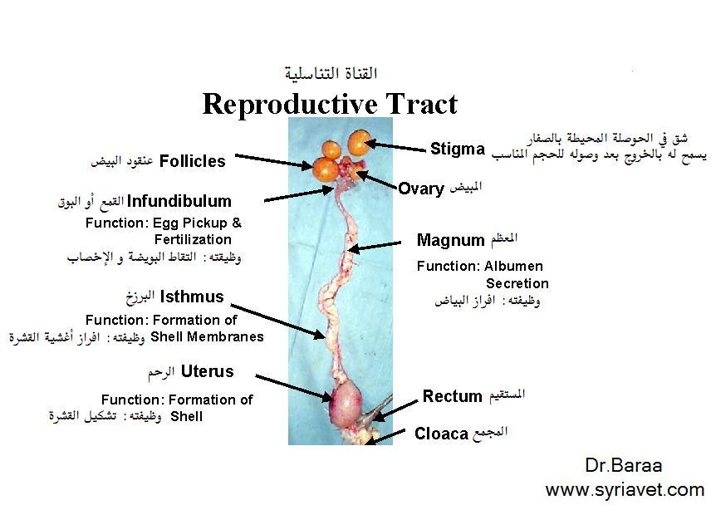
Notes:
Infundibulum - funnels, captures released ova
2 ova released simultaneously produce “double-yolked” egg
Ovum spends ~18 minutes here in chicken

Slide 19
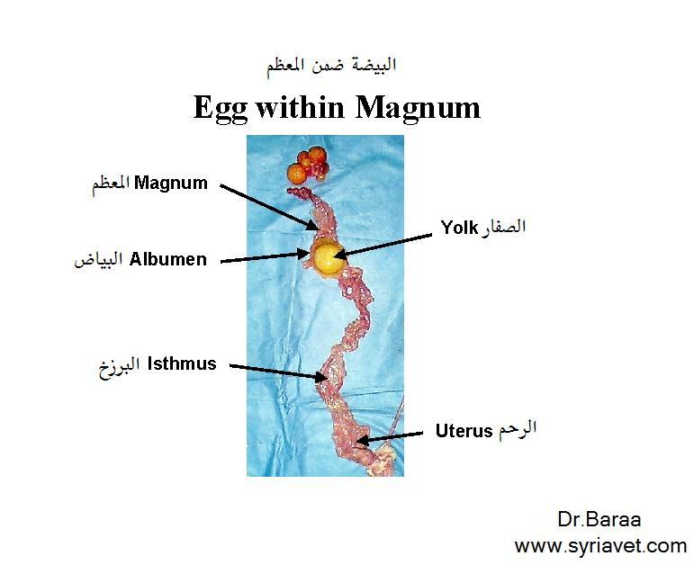
Notes:
Ovum spends ~4 hrs here in chicken

Slide 20
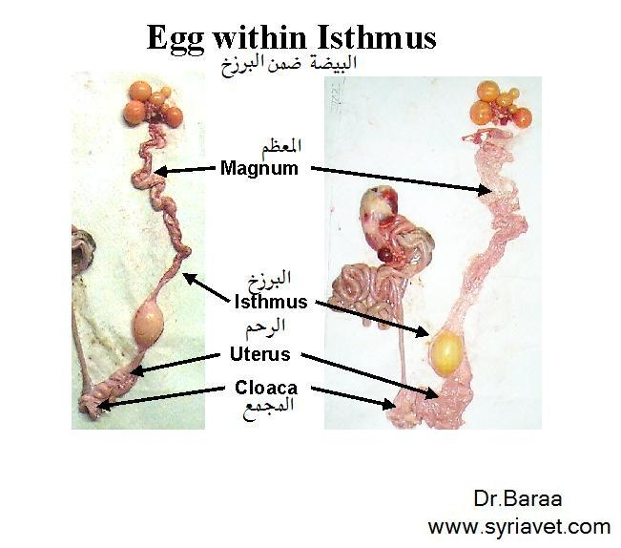
Notes:
Ovum spends ~1.25 hrs here in chicken

Slide 21
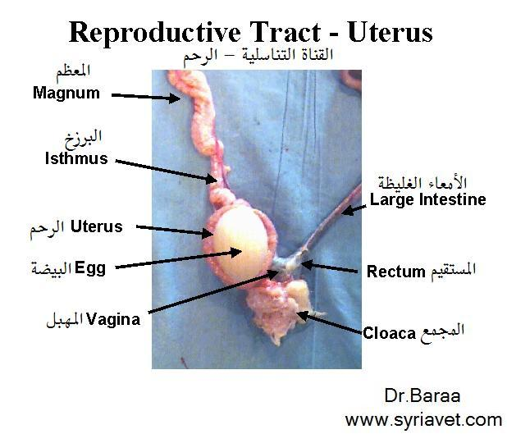
Notes:
Ovum spends ~18-20 hrs here in chicken
chicken - just passing through!

Slide 22
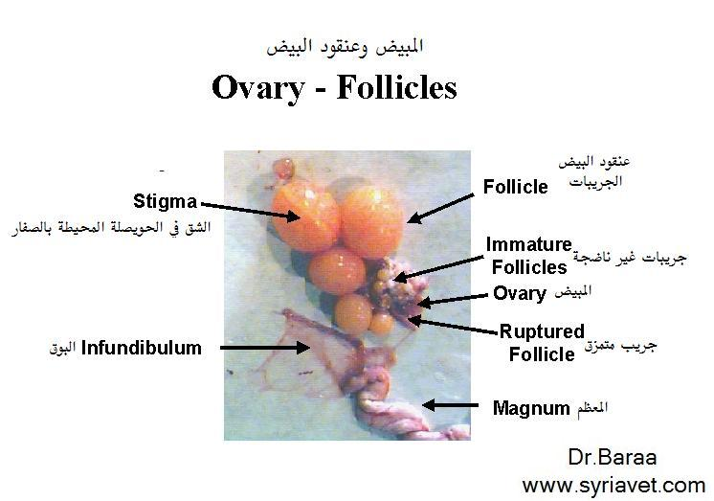

Slide 24
